Slide 1
Final Project Design and Implementation of Guided Image Filter
VLSI Signal Processing
R07943017 謝世暐
R07943018 周育辰

Slide 2
Outline
What is guided image filter
Guided image filter algorithm
Hardware architecture
Architectural transform
Data-interleaving on IIE and divider
Synthesis result and comparison
Notes:
Why this design is important? and/or why you are interested?

Slide 3
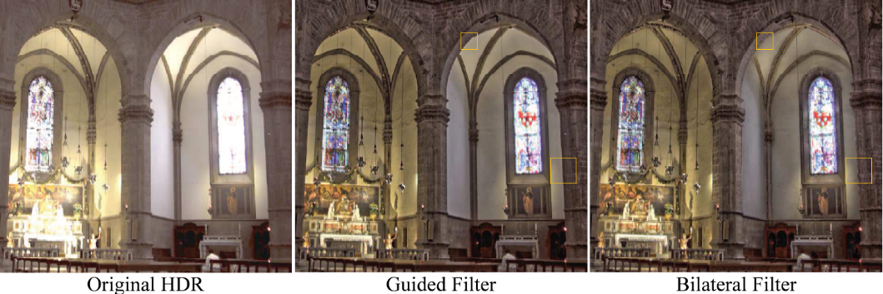
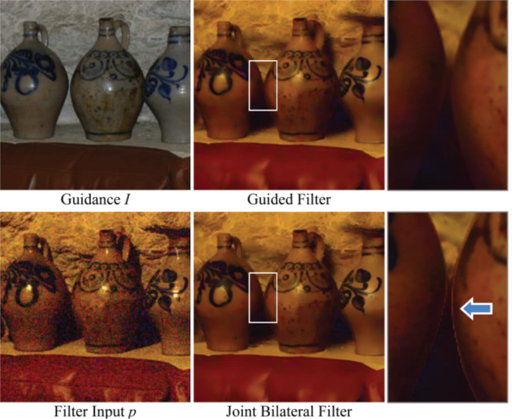
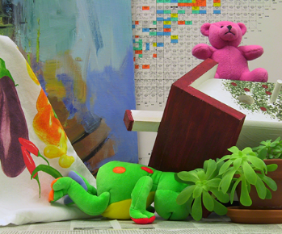
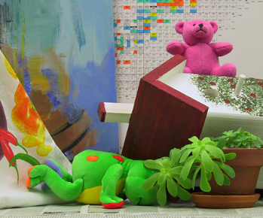
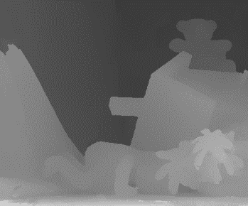
Motivation
Guided image filter is an edge-preserving filter that can run in constant time
A wide range of application in the modern computer vision world uses guided image filtering
Left image
Right image
Disparity
Notes:
Why this design is important? and/or why you are interested?

Slide 4

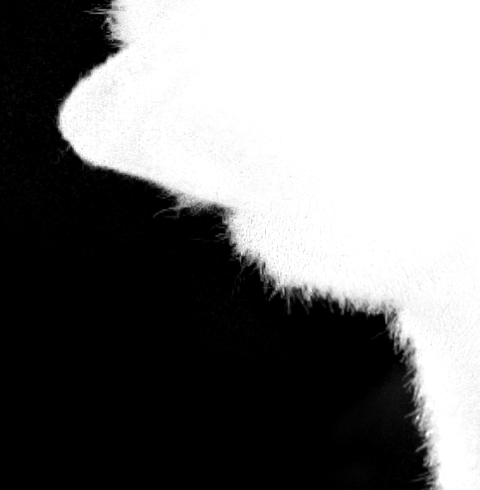
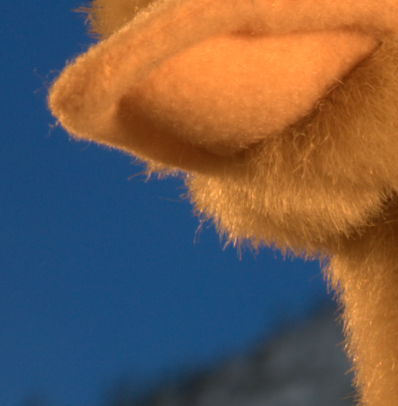
Guided Image Filter Example
Image matting:
Input Image
Guided Image
Notes:
Why this design is important? and/or why you are interested?

Slide 5
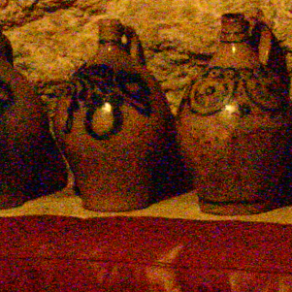

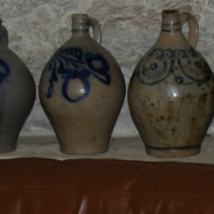
Guided Image Filter Example
Flash/ no-flash denoising:
Input Image
Guided Image
Notes:
Why this design is important? and/or why you are interested?

Slide 6
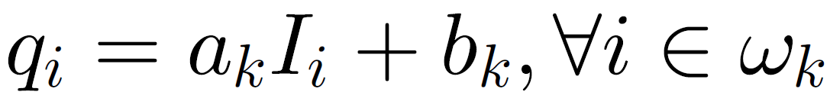
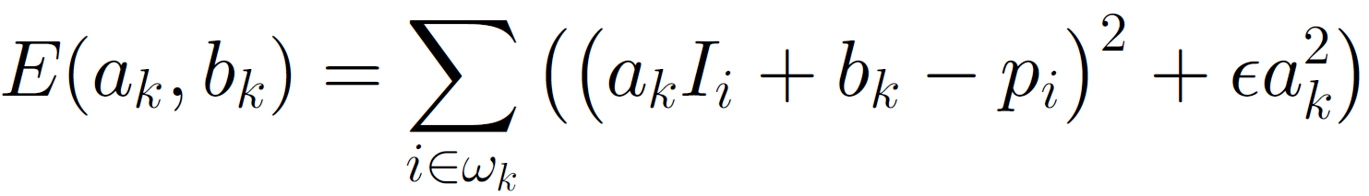
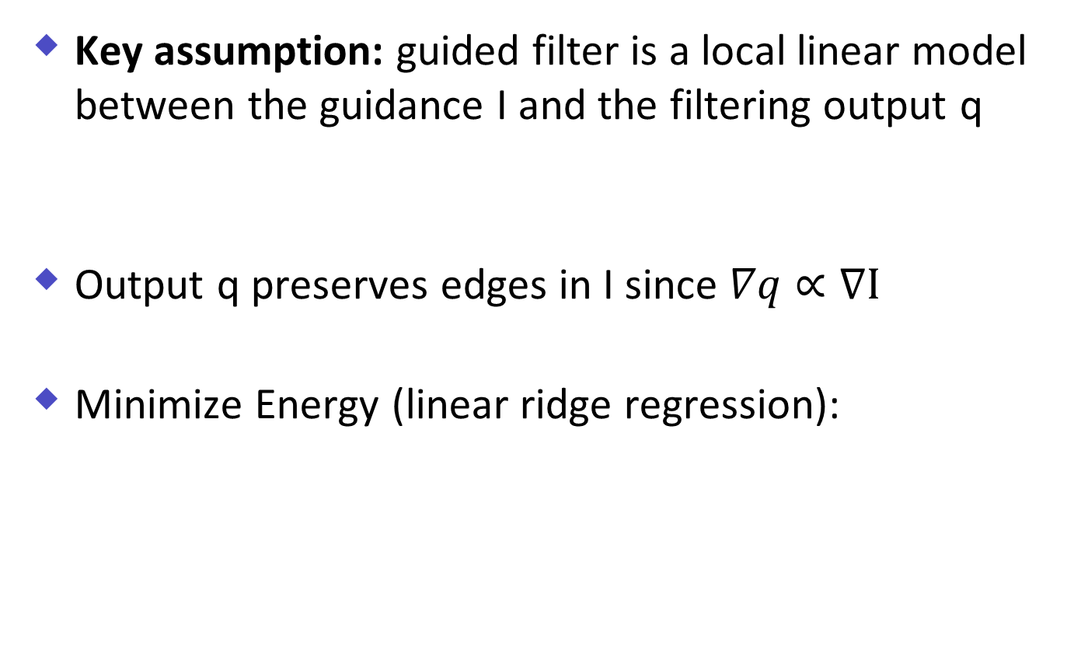
Guided Image Filter
Key assumption: guided filter is a local linear model between the guidance I and the filtering output q
Output q preserves edges in I since $∇q∝∇I$
Minimize Energy (linear ridge regression):
Output
Local window
Guidance image
Data term
Regularization term
Notes:
Why this design is important? and/or why you are interested?

Slide 7

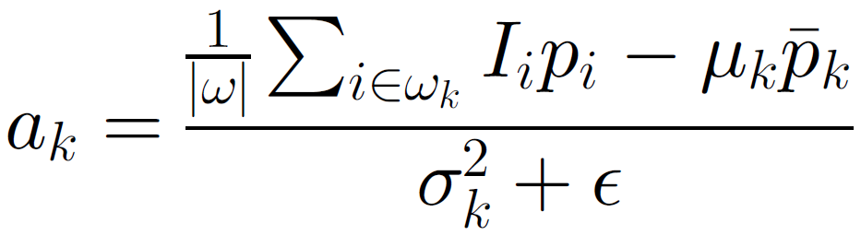


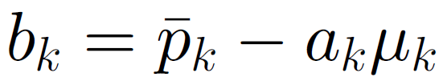
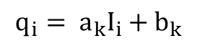
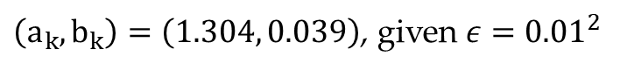
Guided Image Filter
Minimize Energy:
Cov(I, p)
Input
var(I)
Output
$$q_{i}= a_{k}I_{i}+b_{k}$$
Guidance
$\left(a_{k}, b_{k}\right)=\left(1.304, 0.039\right)$, given $ε={0.01}^{2}$
Notes:
Why this design is important? and/or why you are interested?

Slide 8
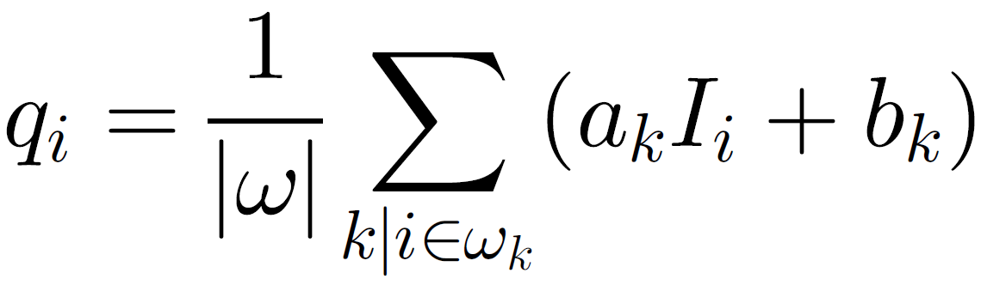
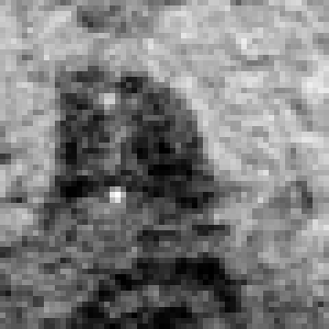

Guided Image Filter
Final output: average all the possible values of qi in all overlapping windows
…
0.2385
Average: 0.2180
0.2227
…
Notes:
Why this design is important? and/or why you are interested?

Slide 9
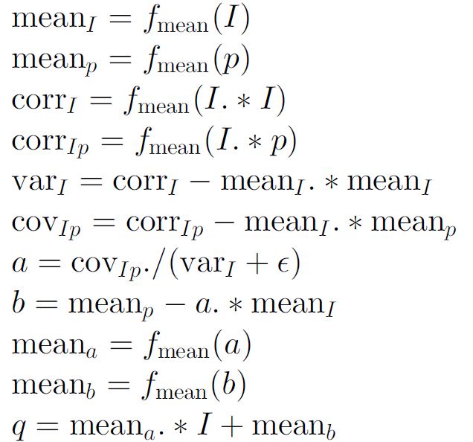
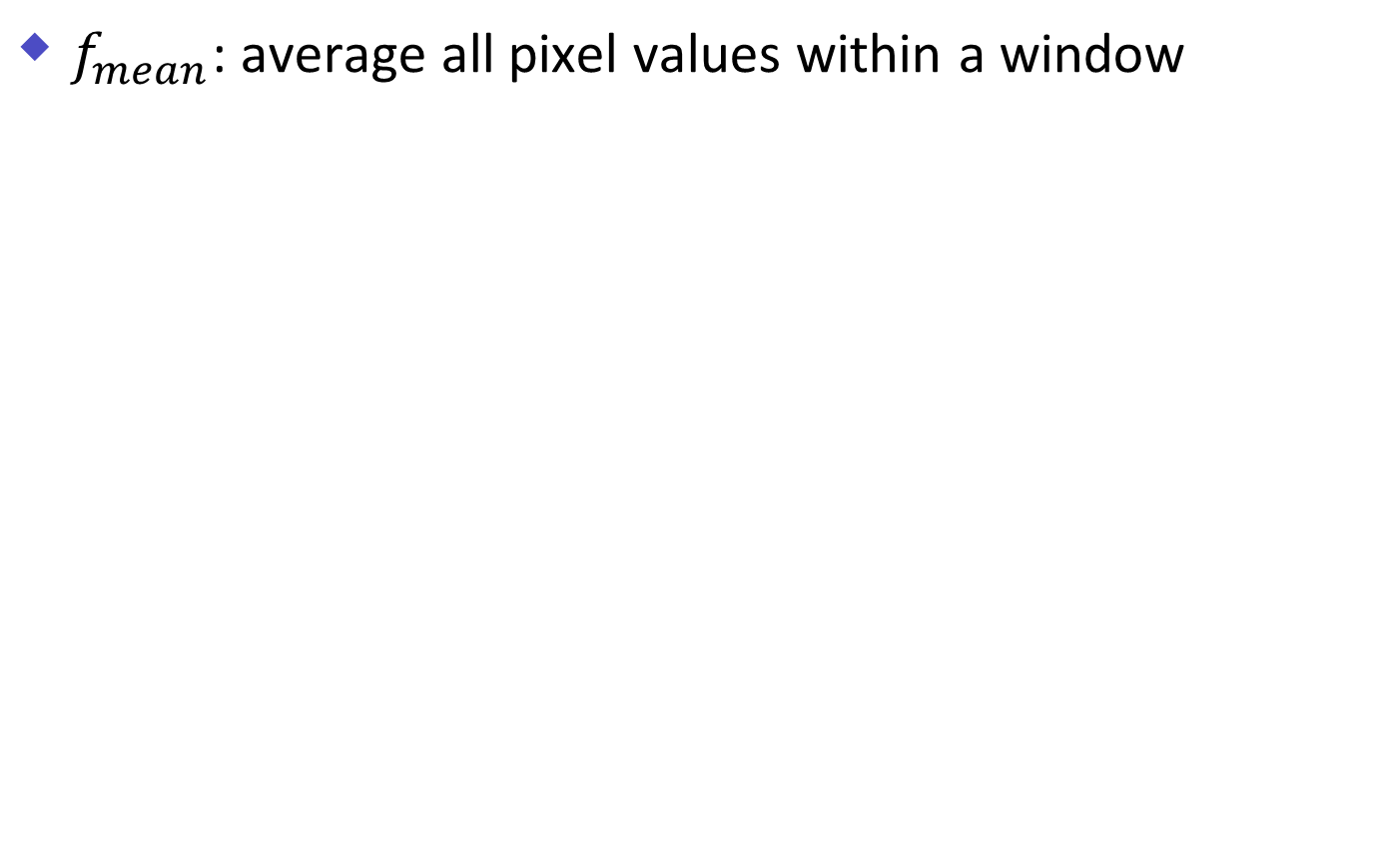
Guided Image Filter Design
$f_{mean}$: average all pixel values within a window
First Stage
Second Stage
Third Stage
Fourth Stage
Software
Hardware
Notes:
Why this design is important? and/or why you are interested?

Slide 10
Design Goal
Design a 30fps full-HD (1920*1080) Guided image filter hardware
Prior work:
Kao, Chieh-Chi, Jui-Hsin Lai, and Shao-Yi Chien. "VLSI architecture design of guided filter for 30 frames/s full-HD video." IEEE Transactions on Circuits and Systems for Video Technology 24.3 (2013): 513-524.
Design goal:
From RTL to Gate-level
Architectural transform: data-interleaving
Notes:
Let others know the content of this project and your design goal.

Slide 11
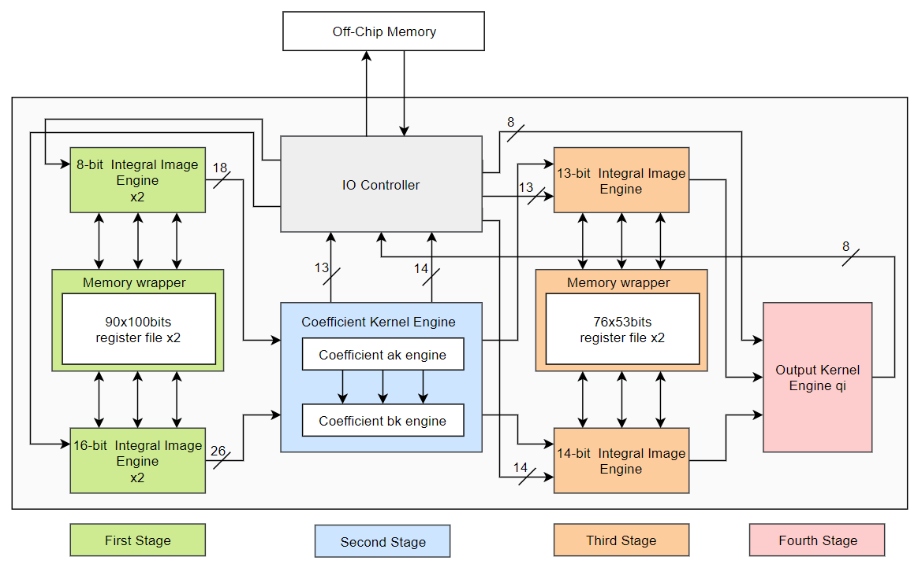
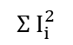
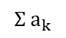
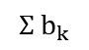
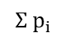
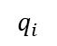
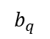
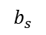
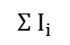
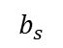
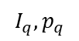
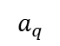
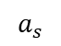
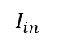
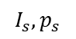
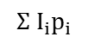
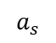
Design Architecture
$$I_{s}, p_{s}$$
$$I_{in}$$
$$I_{q}, p_{q}$$
$$a_{s}$$
$$Σ a_{k}$$
$$Σ I_{i}$$
$$a_{q}$$
$$Σ p_{i}$$
$$q_{i}$$
$$a_{s}$$
$$b_{s}$$
$$b_{s}$$
$$Σ I_{i}^{2}$$
$$Σ b_{k}$$
$$Σ I_{i}p_{i}$$
$$b_{q}$$
Notes:
Put literature review related to your work here.

Slide 12
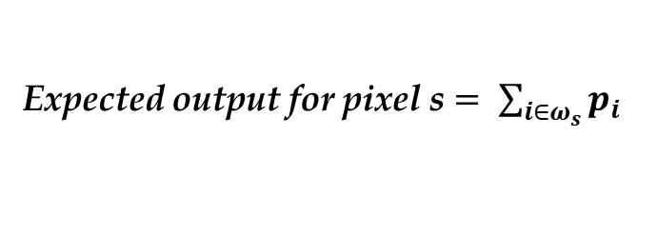

Integral Image engine
Expected output
Window size: 5
 |  |  |  |  |  |  | S
$$ω_{s}$$
Expected output for pixel s $= \sum_{i∈ω_{s}}{p_{i}}$
Notes:
Let others know the content of this project and your design goal.

Slide 13
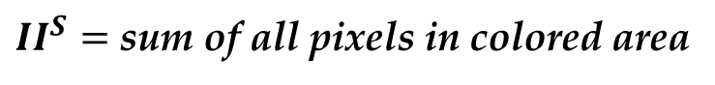
Integral Image engine
Integration part
Window size: 5
 |  |  |  |  | S
Window size
$II^{S}=$ sum of all pixels in colored area
Notes:
Let others know the content of this project and your design goal.

Slide 14
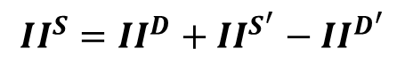
Integral Image engine
Integration part
Window size: 5
 |  |  |  |  | S
D’
S’
D
$$II^{S}=II^{D}+II^{S^{′}}−II^{D^{′}}$$
Notes:
Let others know the content of this project and your design goal.

Slide 15
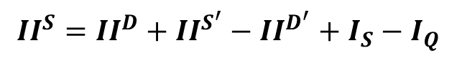
Integral Image engine
Integration part
Window size: 5
 |  |  |  |  | S
Q
$$II^{S}=II^{D}+II^{S^{′}}−II^{D^{′}}+I_{S}−I_{Q}$$
Notes:
Let others know the content of this project and your design goal.

Slide 16
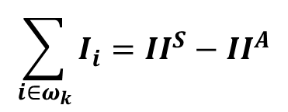
Integral Image engine
Extraction part
Window size: 5
A |  |  |  |  | S
$$\sum_{i∈ω_{k}}{I_{i}}=II^{S}−II^{A}$$
Notes:
Let others know the content of this project and your design goal.

Slide 17
Integral Image engine
Memory view
Window size: 5
shift from S/S’
 |  |  |  | D’ | S’
A |  |  |  | D | S
Read from on-chip memory
write to memory
Notes:
Let others know the content of this project and your design goal.

Slide 18
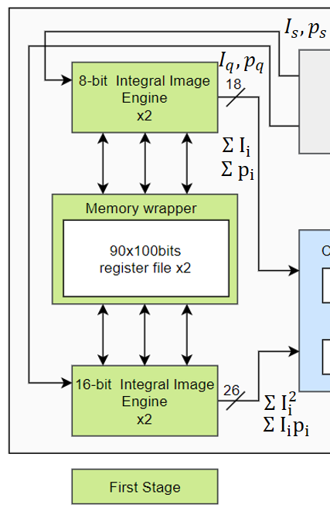
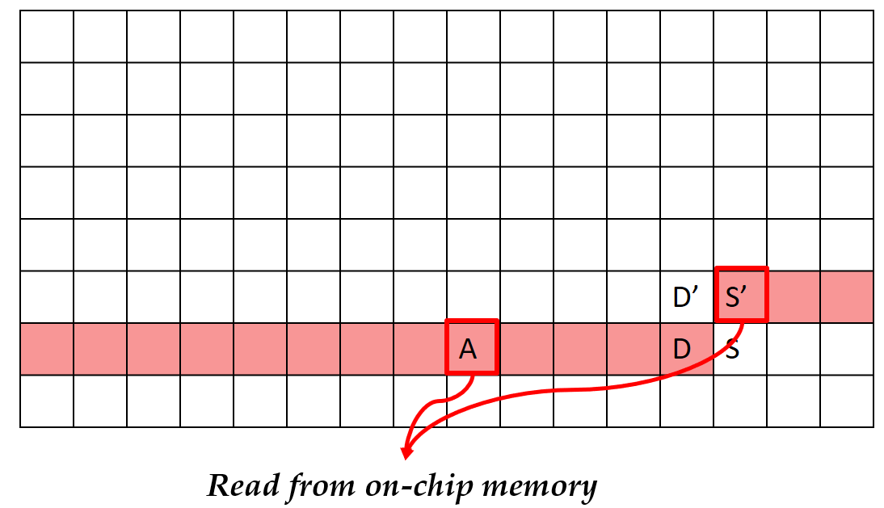
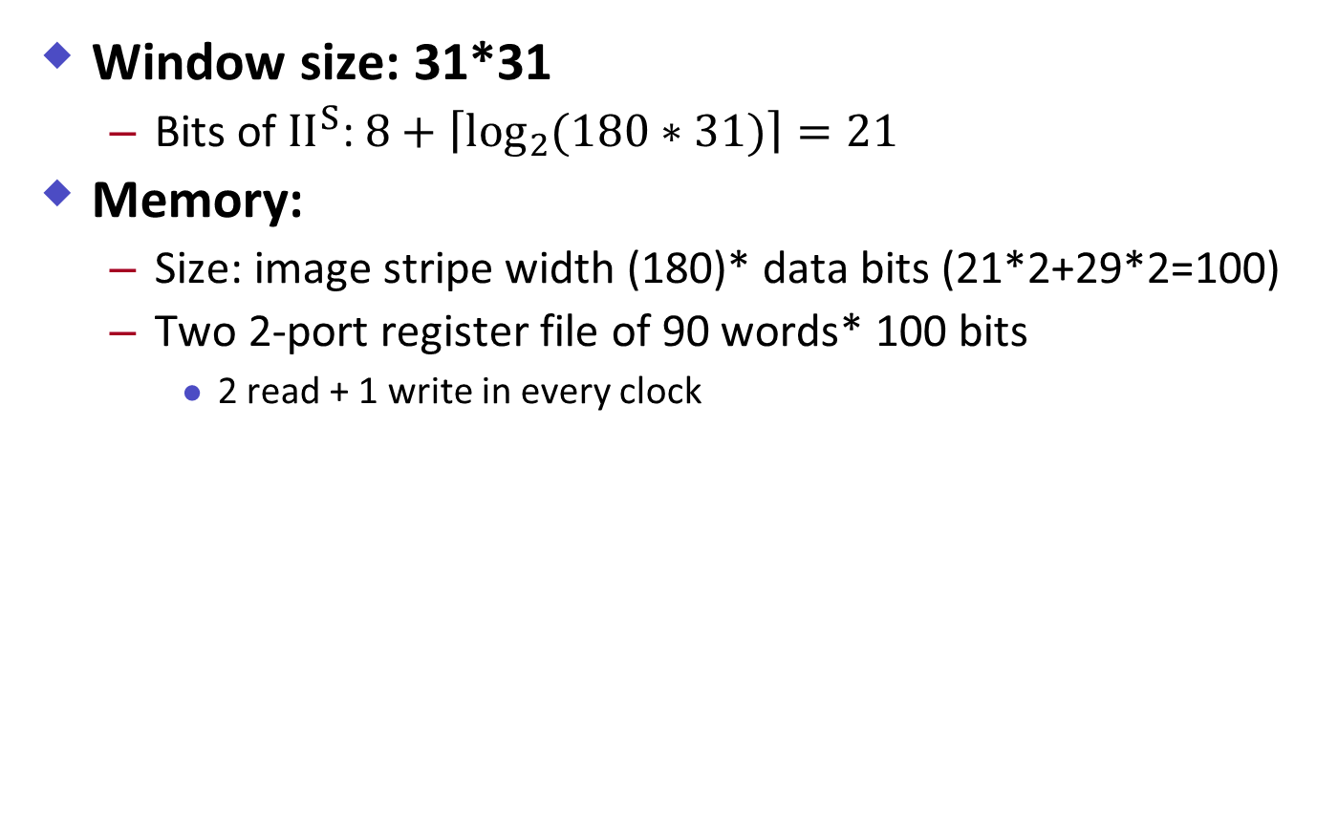
Integral Image engine
Window size: 31*31
Bits of $II^{S}$: $8+\left\lceil \left.\log_{2}{(180∗31)}\right\rceil \right.=21$
Memory:
Size: image stripe width (180)* data bits (21*2+29*2=100)
Two 2-port register file of 90 words* 100 bits
2 read + 1 write in every clock
Notes:
Let others know the content of this project and your design goal.

Slide 19
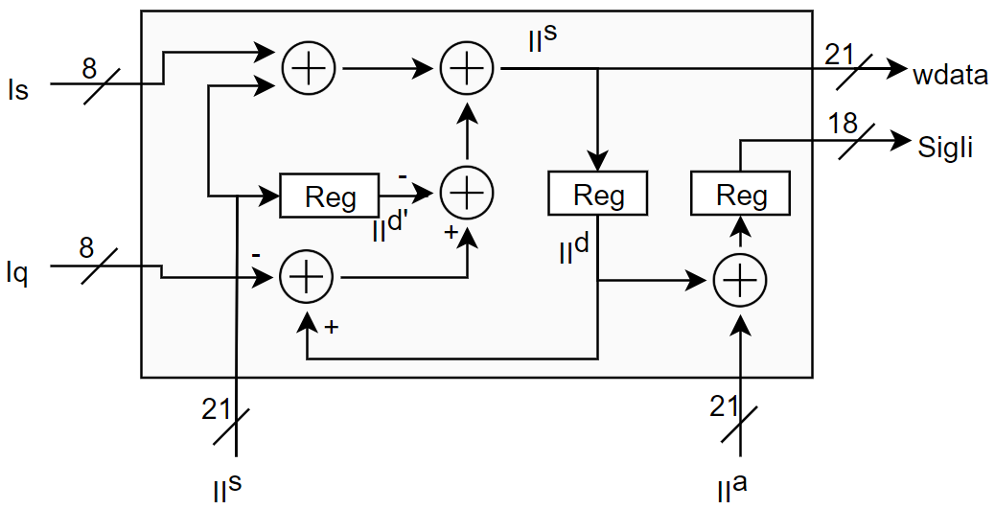
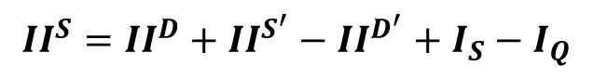
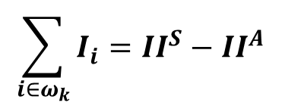
Integral Image engine
Hardware for IIE:
Latency: 2 clock cycle
$$II^{S}=II^{D}+II^{S^{′}}−II^{D^{′}}+I_{S}−I_{Q}$$
$$\sum_{i∈ω_{k}}{I_{i}}=II^{S}−II^{A}$$
Notes:
Let others know the content of this project and your design goal.

Slide 20
Design Architecture
$$I_{s}, p_{s}$$
$$I_{q}, p_{q}$$
$$a_{s}$$
$$Σ a_{k}$$
$$Σ I_{i}$$
$$a_{q}$$
$$Σ p_{i}$$
$$q_{i}$$
$$a_{s}$$
$$b_{s}$$
$$b_{s}$$
$$Σ I_{i}^{2}$$
$$Σ b_{k}$$
$$Σ I_{i}p_{i}$$
$$b_{q}$$
Notes:
Put literature review related to your work here.

Slide 21
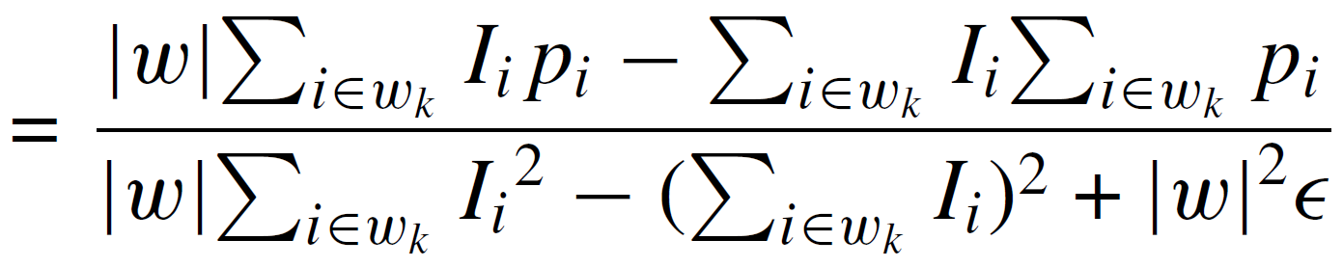
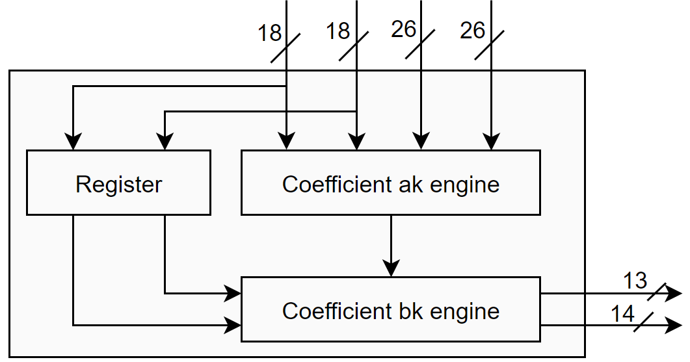






Coefficient Kernel Engine
Coefficient ak and bk engine
$$\sum_{i∈w_{k}}{I_{i}}$$
$$\sum_{i∈w_{k}}{p_{i}}$$
$$\sum_{i∈w_{k}}{{I_{i}p}_{i}}$$
$$\sum_{i∈w_{k}}{I_{i}^{2}}$$
$$a_{k}$$
$$b_{k}$$
Notes:
Let others know the content of this project and your design goal.

Slide 22






Coefficient Kernel Engine
Coefficient ak engine
$${\left|ω\right|}^{2}ϵ$$
$$\sum_{i∈w_{k}}{I_{i}^{2}}$$
$$\sum_{i∈w_{k}}{{I_{i}p}_{i}}$$
$$a_{k}$$
$$\sum_{i∈w_{k}}{I_{i}}$$
10 stages pipelined
divider
$$\sum_{i∈w_{k}}{p_{i}}$$
Notes:
Let others know the content of this project and your design goal.

Slide 23



Coefficient Kernel Engine
Coefficient bk engine
Similar to fourth stage
$$\sum_{i∈w_{k}}{p_{i}}$$
$$\sum_{i∈w_{k}}{I_{i}}$$
$$a_{k}$$
5 stages pipelined
divider
$$b_{k}$$
Notes:
Let others know the content of this project and your design goal.

Slide 24


Coefficient Kernel Engine
Coefficient ak/ bk engine
Wordlength (fraction bits) vs. PSNR (db)
# of fractional bits of ak affects more than bk
Choice of # of bits also depends on application/ window size
Final choice of fractional bits $\left(a_{k},b_{k}\right)=(8, 1)$
Notes:
Let others know the content of this project and your design goal.

Slide 25
Design Architecture
Similar to First Stage
Similar to bk engine
$$I_{s}, p_{s}$$
$$I_{q}, p_{q}$$
$$a_{s}$$
$$Σ a_{k}$$
$$Σ I_{i}$$
$$a_{q}$$
$$Σ p_{i}$$
$$q_{i}$$
$$a_{s}$$
$$b_{s}$$
$$b_{s}$$
$$Σ I_{i}^{2}$$
$$Σ b_{k}$$
$$Σ I_{i}p_{i}$$
$$b_{q}$$
Notes:
Put literature review related to your work here.

Slide 26









Achieving speed of 30 fps
Window size = $(2α+1, 2α+1)$
Stripe width = $ω_{s}$; $\left(H_{f},W_{f}\right)=(1080, 1920)$
Total number of computation cycle:
$\left\lceil \left.W_{f}/ω_{s}\right\rceil \right.∗\left(ω_{s}+4α\right)∗\left(H_{f}+3α\right)$
$$2α$$
$$ω_{S}$$
$$2α$$
$$2α$$
$$ω_{S}$$
$$2α$$
overlap
Notes:
Let others know the content of this project and your design goal.

Slide 27




Achieving speed of 30 fps
Window size = $(2α+1, 2α+1)$
Stripe width = $ω_{s}$; $\left(H_{f},W_{f}\right)=(1080, 1920)$
Total number of computation cycle:
$\left\lceil \left.W_{f}/ω_{s}\right\rceil \right.∗\left(ω_{s}+4α\right)∗\left(H_{f}+3α\right)$
Choose $ω_{s}=120$
$$Speed:\left\{\begin{aligned}2.025 ms/stripe \\ 32.4 ms/frame \\ \text{0.972 }\text{s}\text{/30 }\text{frame}\end{aligned}\right.$$
Notes:
Let others know the content of this project and your design goal.

Slide 28



Synthesis result
Technology: TSMC 40 nm
High/ Regular/ Low threshold voltage cells
 | Original design (100 MHz)
Dynamic Power | 5.314 mW
Leakage Power | 0.9766 mW
Total Power | 6.290 mW
Memory Area | 43724.41
Comb+ Noncomb Area | 37733.85
Total Area ($μm^{2}$) | 81458.26
Hvt/Rvt/Lvt ratio | 80.00/ 9.00/ 11.00%
Notes:
Let others know the content of this project and your design goal.

Slide 29
Architectural Transform
Data-Interleaving
Notes:
Let others know the content of this project and your design goal.

Slide 30

Architectural Transform
Original IIE engine
$$Σ I_{i}$$
$$Σ p_{i}$$
Notes:
Let others know the content of this project and your design goal.

Slide 31


Architectural Transform
Data-interleaved IIE engine
Same unit
$$Σ I_{i}$$
$$Σ p_{i}$$
$$Σ I_{i}$$
Notes:
Let others know the content of this project and your design goal.

Slide 32







Architectural Transform
Data-interleaved IIE engine
$$p_{S}$$
$$I_{S}$$
$${Sig}_{p_{S}}$$
$$Sig_{I_{i}}$$
$$p_{Q}$$
$$I_{Q}$$
For accuracy
Notes:
Let others know the content of this project and your design goal.

Slide 33



Synthesis result
Technology: TSMC 40 nm
High/ Regular/ Low threshold voltage cells
 | Original design (100 MHz) | Transformed design
Dynamic Power | 5.314 mW | 7.503 mW
Leakage Power | 0.9766 mW | 1.088 mW
Total Power | 6.290 mW | 8.591 mW
Memory Area | 43724.41 | 43724.41
Comb+ Noncomb Area | 37733.85 | 35583.79
Total Area ($μm^{2}$) | 81458.26 | 79308.20
Hvt/Rvt/Lvt ratio | 80.00/ 9.00/ 11.00% | 64.79/13.97/ 21.24%
Notes:
Let others know the content of this project and your design goal.

Slide 34

Architectural Transform
Result discussions:
IIE unit: 6 $→$ 3 (saved 15 adders)
Need to handle parallel to serial/ serial to parallel problem
Extra registers
Less timing margin
The critical area part of the entire design may not lies in IIE
We also tried sharing divider by architectural transform
Notes:
Let others know the content of this project and your design goal.

Slide 35
Design Architecture
Shared divider
$$I_{s}, p_{s}$$
$$I_{q}, p_{q}$$
$$a_{s}$$
$$Σ a_{k}$$
$$Σ I_{i}$$
$$a_{q}$$
$$Σ p_{i}$$
$$q_{i}$$
$$a_{s}$$
$$b_{s}$$
$$b_{s}$$
$$Σ I_{i}^{2}$$
$$Σ b_{k}$$
$$Σ I_{i}p_{i}$$
$$b_{q}$$
Notes:
Put literature review related to your work here.

Slide 36



Architectural Transform
Interleaved architecture
$$\sum_{i∈w_{k}}{p_{i}}$$
$$\sum_{i∈w_{k}}{I_{i}}$$
$$a_{k}$$
$$b_{k}$$
a1, b1
a1, b1
a2, b2
a2, b2
out1
out
out2
out d1
Notes:
Let others know the content of this project and your design goal.

Slide 37


Synthesis results comparison
Power-Area Product: $A <C <B$
A
B
C
 | Original design (100 MHz) | Transformed design (IIE) | Transformed design (IIE+div)
Dynamic Power | 5.314 mW | 7.503 mW | 7.735 mW
Leakage Power | 0.9766 mW | 1.088 mW | 1.033 mW
Total Power | 6.290 mW | 8.591 mW | 8.768 mW
Memory Area | 43724.41 | 43724.41 | 43724.41
Comb+ Noncomb Area | 37733.85 | 35583.79 | 33760.77
Total Area ($μm^{2}$) | 81458.26 | 79308.20 | 77485.18
Hvt/Rvt/Lvt ratio | 80.00/ 9.00/ 11.00% | 64.79/13.97/21.24% | 64.43/15.24/20.34%
Notes:
Let others know the content of this project and your design goal.

Slide 38

Result Comparison
Matlab (guided image filter author):
Notes:
Let others know the content of this project and your design goal.

Slide 39

Result Comparison
Our result (Verilog output):
PSNR: 49.5341
Notes:
Let others know the content of this project and your design goal.

Slide 40
Conclusions
We implemented a 30 fps full-HD guided image filter hardware
The relation between word length of intermediate coefficient and the final performance is analyzed
We applied data-interleaving on integral image engine and pipelined divider to examine the effect of architectural transform
We found that the original design still has the lowest power-area product

Slide 41
References
He, Kaiming, Jian Sun, and Xiaoou Tang. "Guided image filtering." IEEE transactions on pattern analysis and machine intelligence 35.6 (2012): 1397-1409.
Kao, Chieh-Chi, Jui-Hsin Lai, and Shao-Yi Chien. "VLSI architecture design of guided filter for 30 frames/s full-HD video." IEEE Transactions on Circuits and Systems for Video Technology 24.3 (2013): 513-524.

Slide 42

Appendix
Analysis of different pipeline stages of DW_div_pipe
Pipeline stages | 2 | 4 | 8 | 2 | 4 | 8
Cycle time | 2.0ns |  |  | 5.0ns
Dynamic Power | 2.344 mW | 2.137 mW | 1.083 mW | 0.779 mW | 0.500 mW | 0.499 mW
Leakage Power | 0.454 mW | 0.208 mW | 0.119 mW | 0.092 mW | 0.057 mW | 0.023 mW
Total Power | 2.798 mW | 2.345 mW | 1.202 mW | 0.871 mW | 0.557 mW | 0.522 mW
Total Area ($μm^{2}$) | 10878.46 | 7796.25 | 6466.52 | 4830.61 | 4186.50 | 5739.63
Power*Area (mW*$μm^{2}$) | 30437.93 | 18282.21 | 7772.76 | 4207.46 | 2331.88 | 2996.09
Hvt/Rvt/Lvt ratio | 3.91/ 15.86/ 80.24% | 16.40/ 25.79/ 57.81% | 33.91/ 23.24/ 42.85% | 19.67/ 28.85/ 51.47% | 37.25/ 33.50/ 29.25% | 81.70/ 14.30/ 4.01%

